Slide 1
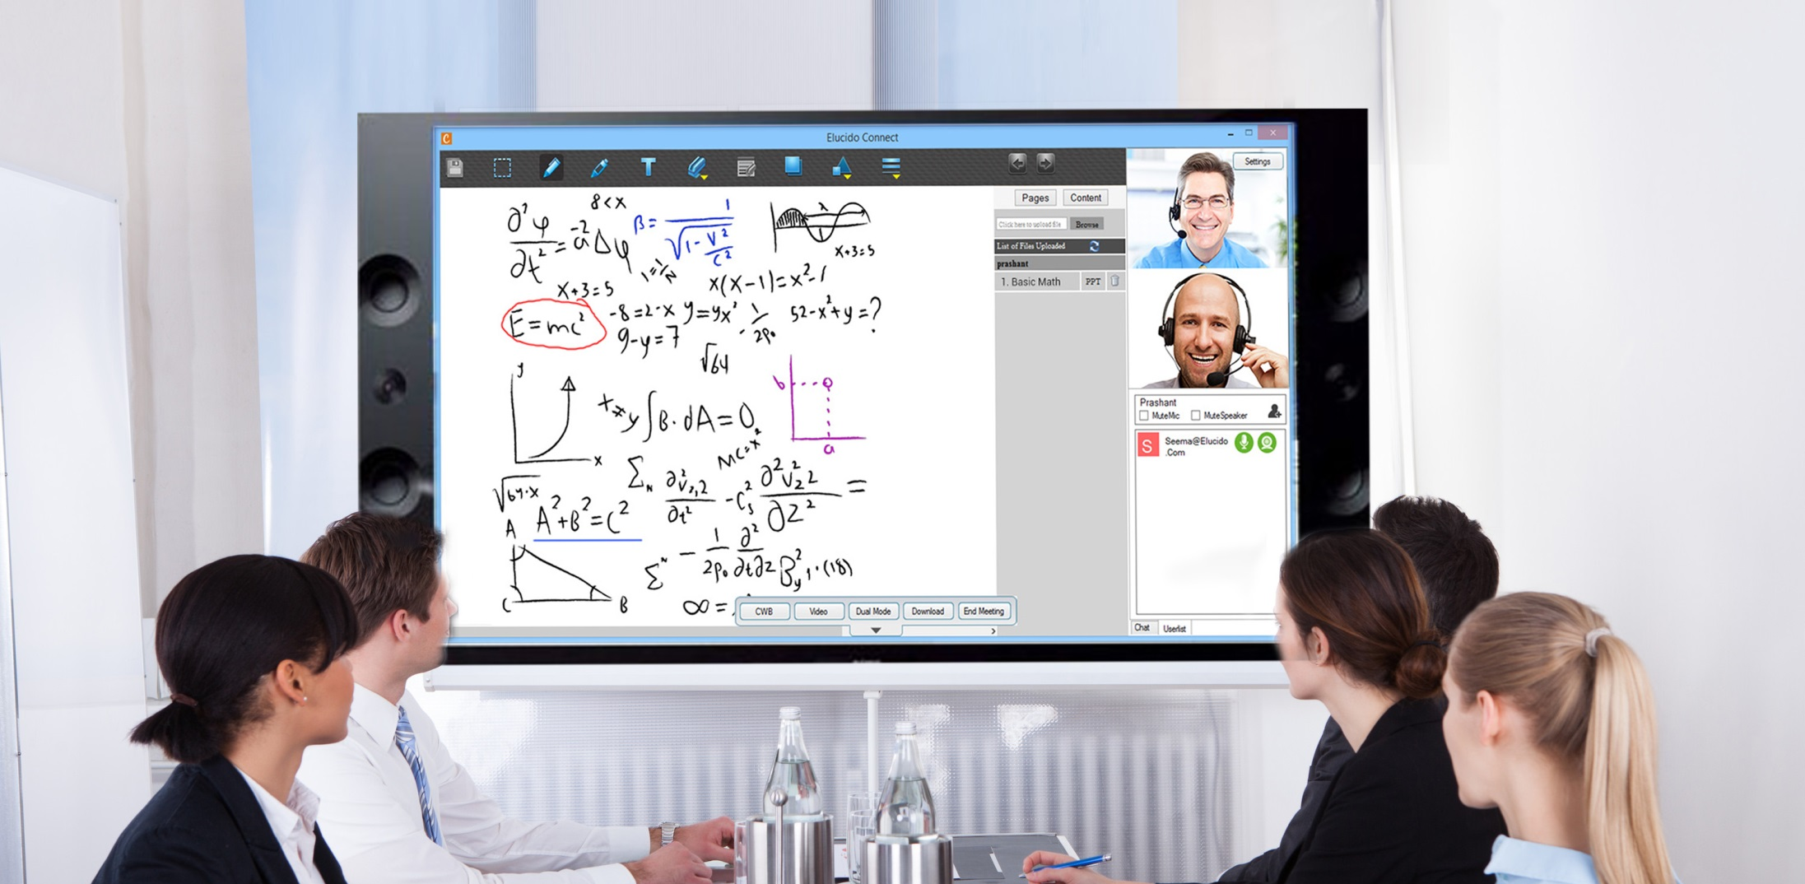

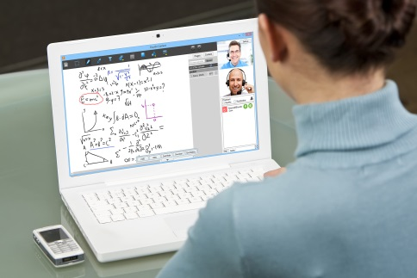
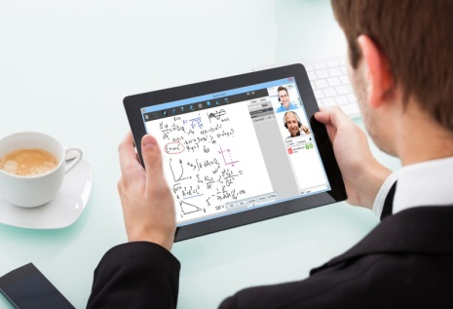
CONNECT

Slide 2
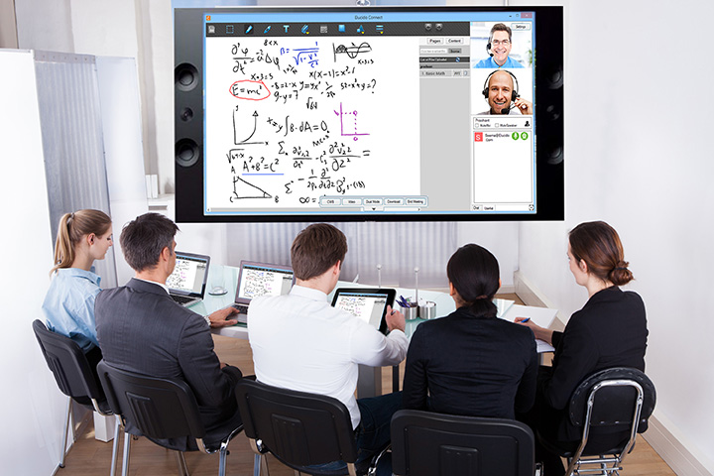

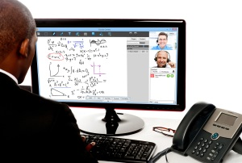
Enhanced Multiparty Collaboration
Collaborate using personal devices AND from conference rooms…
Write, Annotate, Create documents & presentations on the fly…
Experience HD quality Video and Audio…
CONNECT
2

Slide 3
Simple to Use
Schedule
Simple calendar view (Day, Week, Month with time)
One Click Schedule. Pick a date/ time & schedule the meeting
Invite
Collaborate
Send email invitations to participants from within Elucido CONNECT
Presenter & Invitees can upload documents & presentations to be used during the meeting (PPT, PDF)
Review & Save
Participants log in using their credentials
Collaboration tools available are Video, Audio, Chat and a Whiteboard with enhanced writing, annotation and typing features
Participants can download annotated content used during the session as PDF files
These PDF files can be re-used during subsequent sessions
3

Slide 4
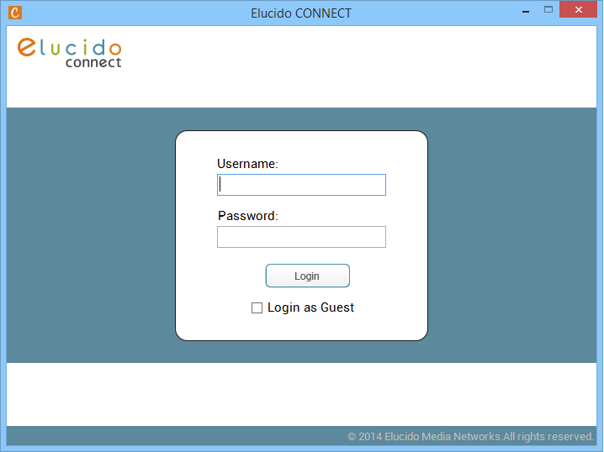
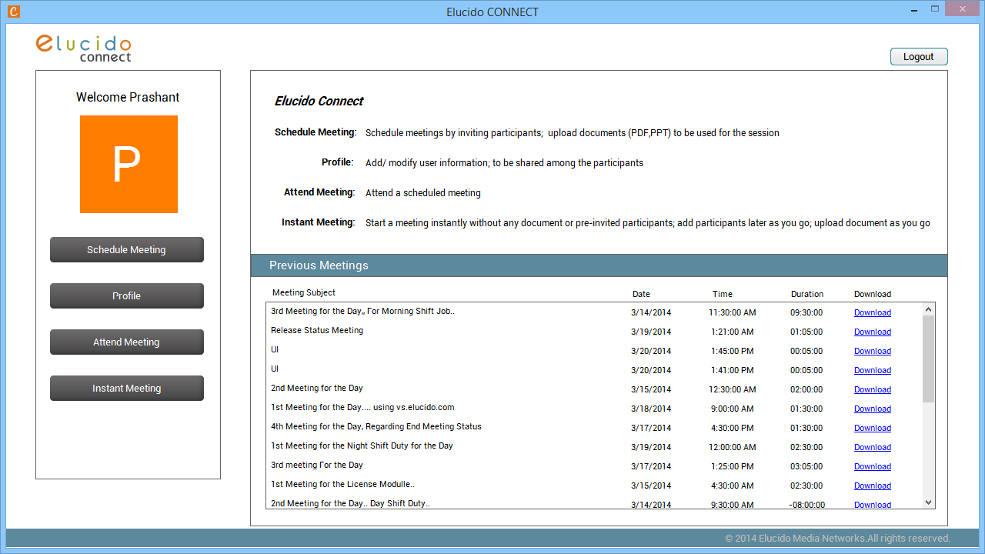
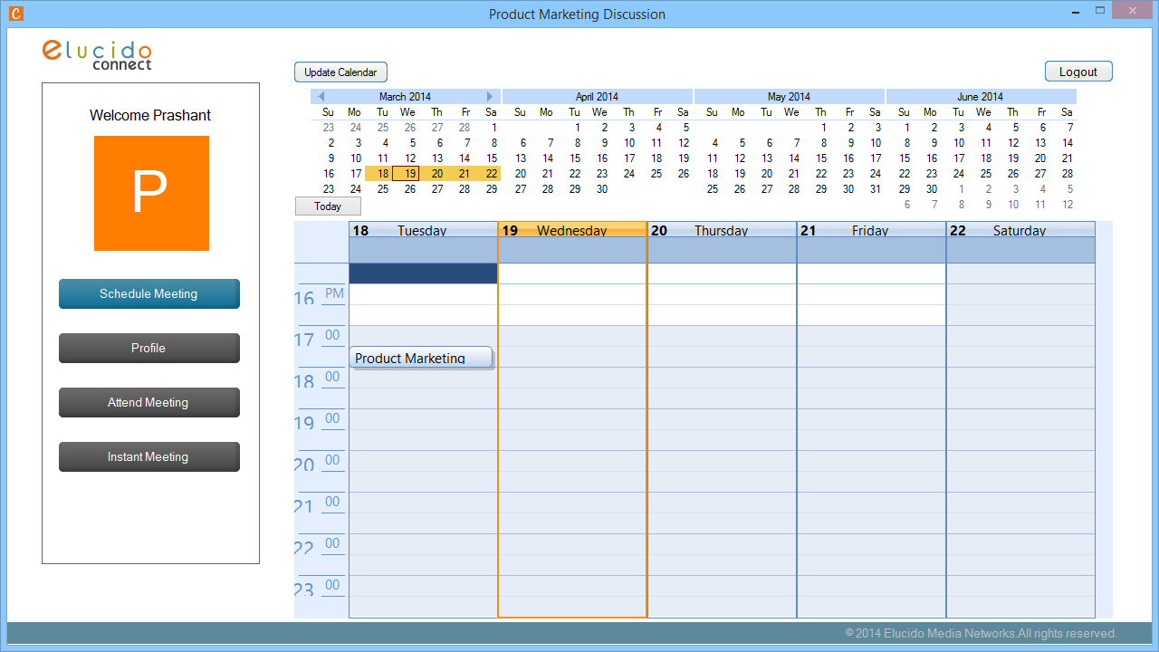
Schedule
Schedule
Invite
Collaborate
Review & Save
Log In
Activity Dashboard
Schedule
4

Slide 5
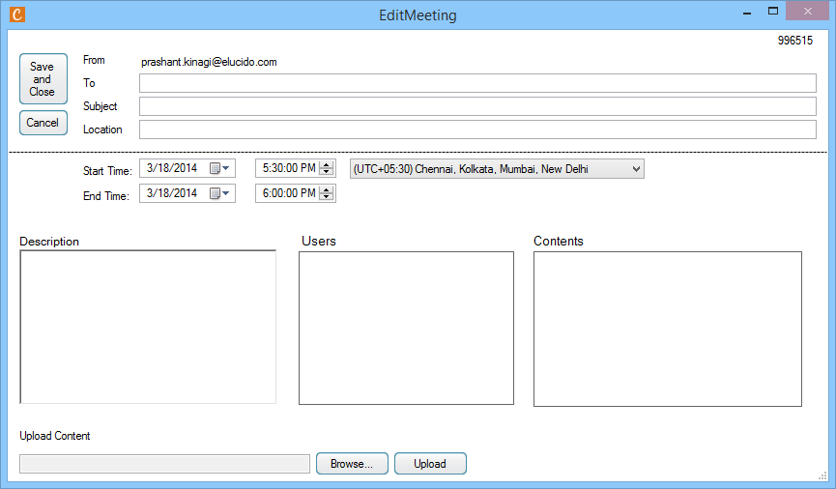
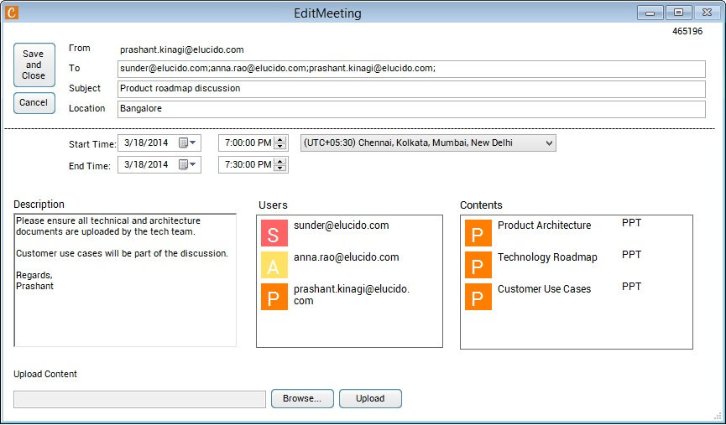
Invite
Schedule
Invite
Collaborate
Review & Save
Invite Participants
Upload documents for the session
5

Slide 6
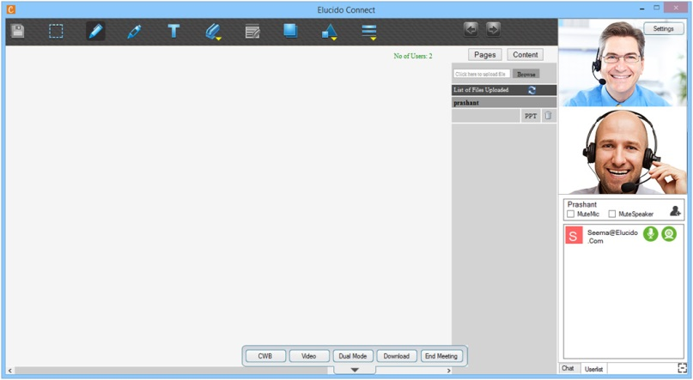
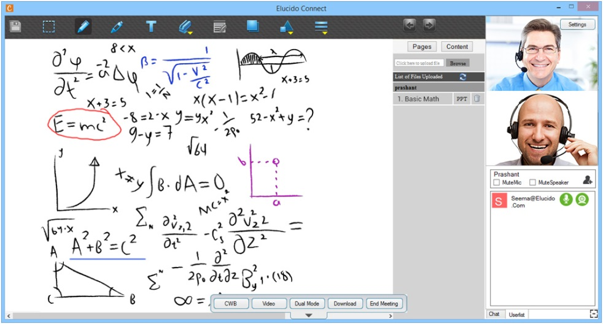
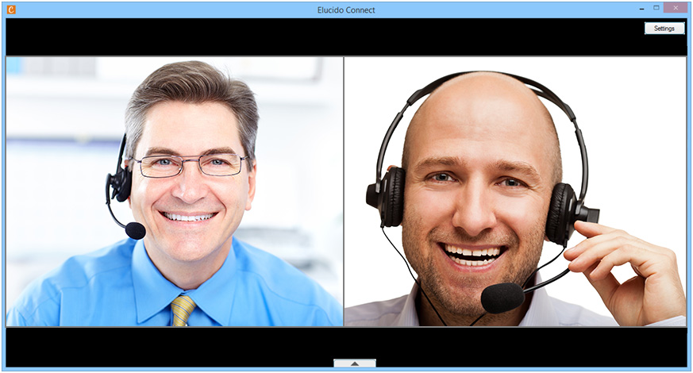
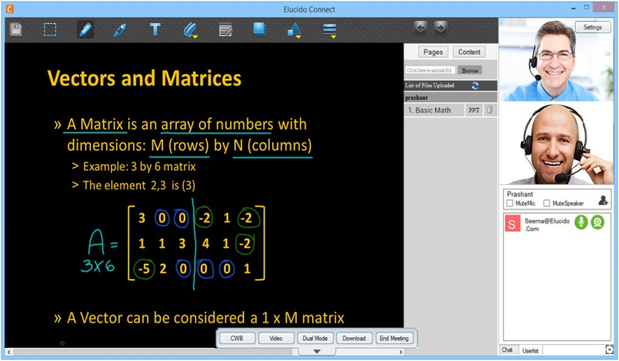
Collaborate
Schedule
Invite
Collaborate
Review & Save
Plain Whiteboard and document list
Writing on the whiteboard along with participant Videos & controls
Desktop Video Conferencing
Annotation on a PPT
6

Slide 7
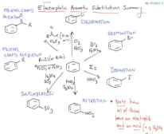

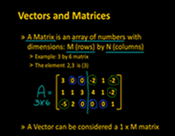
Review & Save
Schedule
Invite
Collaborate
Review & Save
PDF File
Download whiteboard and document annotation at the end of the session as a PDF file
7

Slide 8
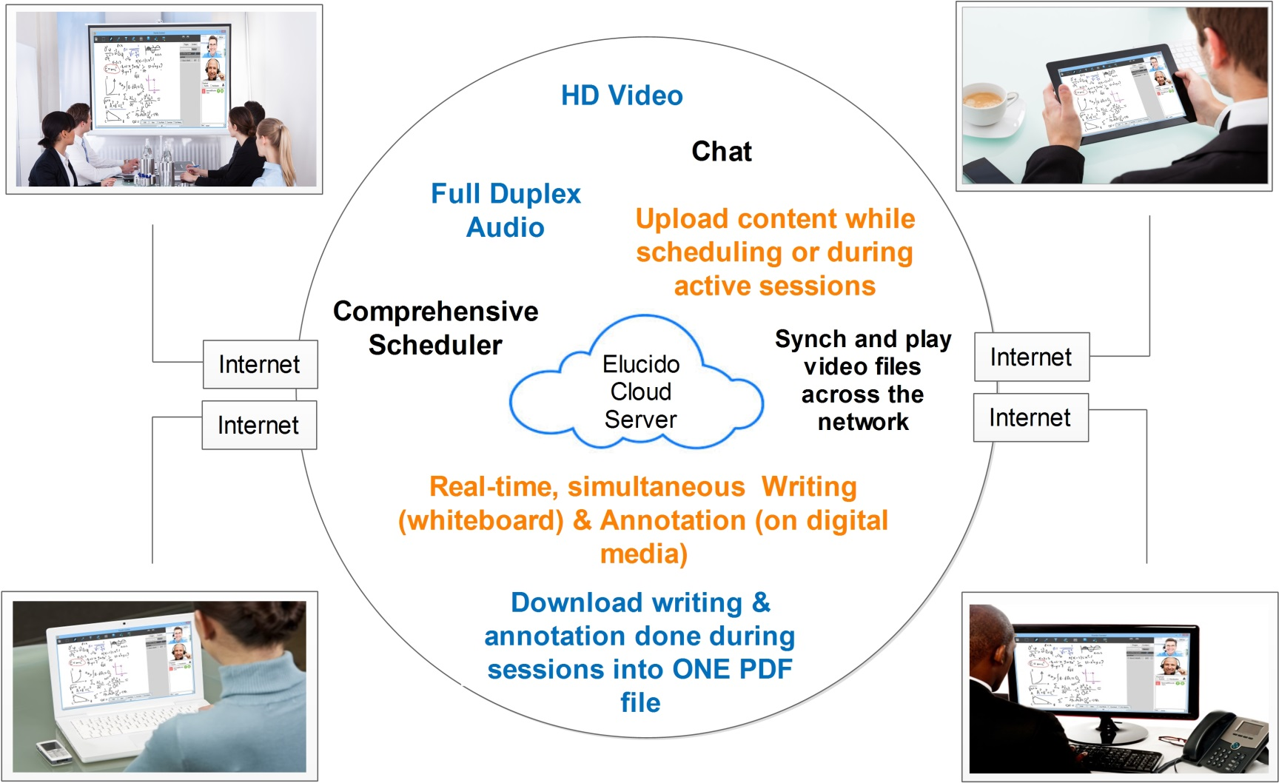
Collaboration Architecture
8

Slide 9
Features Summary
CONNECT is a software product for enabling enhanced multiparty collaboration using Tablets, Smartphones and Laptops
Key Features:
Simultaneous writing and annotation on documents (PDFs & PPTs)
Upload and manage personal documents (all participants)
Full featured meeting scheduling module
Whiteboard with tools for Writing, Annotation and Typing
Chat
Download whiteboard writing and document annotation as one PDF document
Supports multi-environment collaboration (between groups in conference rooms AND individuals using mobile devices & laptops)
9

Slide 10
How is it useful?
CONNECT can be used very effectively in Enterprise and Academic environments
Academic:
Peer to peer collaboration among students after classroom sessions
Peer to peer collaboration among teachers and administrators for lesson planning and for routine meetings
Can be integrated into MOOCs and e-learning platforms to enhance the teaching & learning experience by adding real-time collaboration
Enterprises:
Engineering, Product, Design & Creative team Collaboration: (Remote teams can collaborate by working on common content)
Executive Collaboration: (Routine meetings where remote executives collaborate using Tablets, Smart Phones or Laptops)
Training & Development: (Provides an inclusive training environment where remotely located employees can be trained in real-time by corporate trainers)
10

Slide 11


Thank You
11

